Slide 1
Sentence Level Or Token Level Features For Automatic Short Answer Grading?: Use Both
Swarnadeep Saha, Tejas I. Dhamecha, Smit Marvaniya, Renuka Sindhgatta, Bikram Sengupta
IBM Research – India
{swarnads, tidhamecha, smarvani, renuka.sr, bsengupt}@in.ibm.com

Slide 2
Automatic Short Answer Grading - Problem
Grade a short student answer in reference to a model answer for a given question.
Student and reference answers are typically 1-2 sentences long.
Input is a triple:
Question (Q)
Reference Answer (RA) – Created by Subject Matter Experts (SME)
Student Answer (SA)
Output is either:
A class label – e.g. Correct, Incorrect, etc.
A real valued score within a range – e.g. : 4.5 (Range : [0-5])

Slide 3
Existing Techniques
Supervised learning problem posed as either a classification or regression task depending on labels.
Two main approaches :
Hand-crafted Features
Mostly token-based.
Graph alignment and lexical features (Mohler et al), Soft cardinality features (Jimenez et al), etc.
Sultan et al. - State-of-the-art features based on text alignment, semantic similarity (using word vectors), question demoting, term weighting and length ratios.
Deep Learning Approaches
Learn sentence embeddings (vector representations).
Siamese LSTM networks (Mueller et al.)
EMD pooling over Siamese LSTMs (Kumar et al.)
InferSent (Conneau et al.) – State-of-the-art sentence embeddings and used as transferred features for short answer grading.

Slide 4
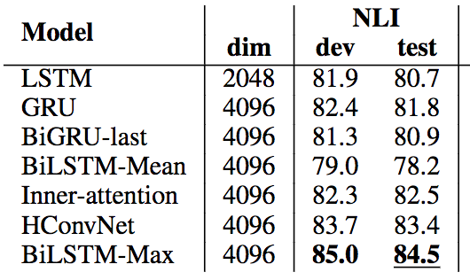
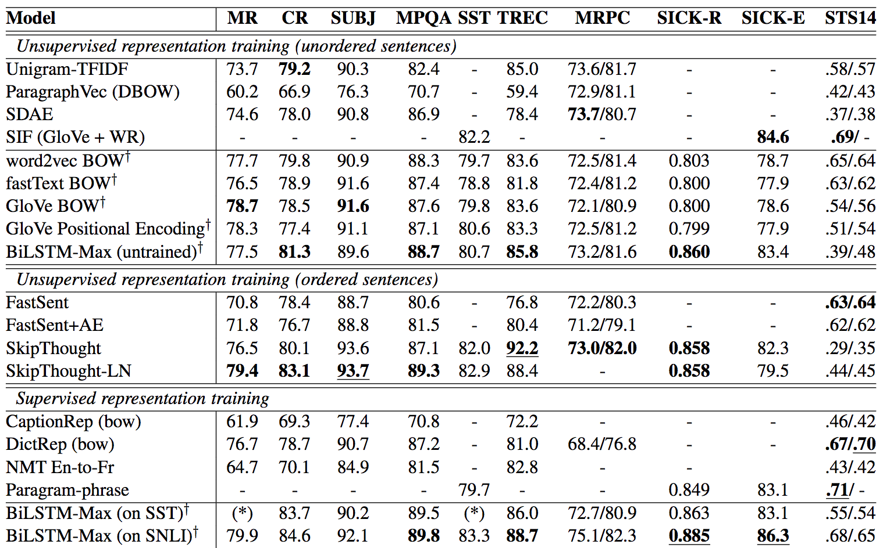
InferSent Recent Sentence Embedding Approach
Claim: DL trained on Natural Inference Learning task, yields embeddings, usable in various other task, including
Sentiment analysis
Product review
Subjectivity/Objectivity
Opinion polarity
Entailment and Semantic Relatedness
Semantic Textual Similarity

Slide 5
Existing Techniques - Limitations
In dialog-based tutoring systems, student answers are either (1) well-formed or (2) non-sentential responses.
Hand-crafted token-level features cannot capture semantics.
Deep learning based sentence embeddings techniques are ineffective when answers are non-sentential and incomplete.

Slide 6
Contributions
Novel token level features
Histogram of Partial Similarity (HoPS) - Novel token level features specifically tuned for understanding partially correct student answers.
Extending HoPS to part-of-speech tags (HoPSTag) and adding question type information.
Adapting deep learning based sentence embedding features to use question information.
Combining token and sentence level features.
Extensive evaluation and state-of-the-art results on 3 datasets:
Proprietary Large-scale Industry Dataset.
SemEval-2013 Dataset (Publicly available).
Mohler et al. Dataset (Publicly available).

Slide 7
Token Level Features – Word Overlap
Word overlap features:
Precision – |RA∩SA|/|SA|
Recall - |RA∩SA|/|RA|
Precision * Recall
Not sufficient!
How do we capture partially correct student answers?
Histogram of Partial Similarities (HoPS)

Slide 8
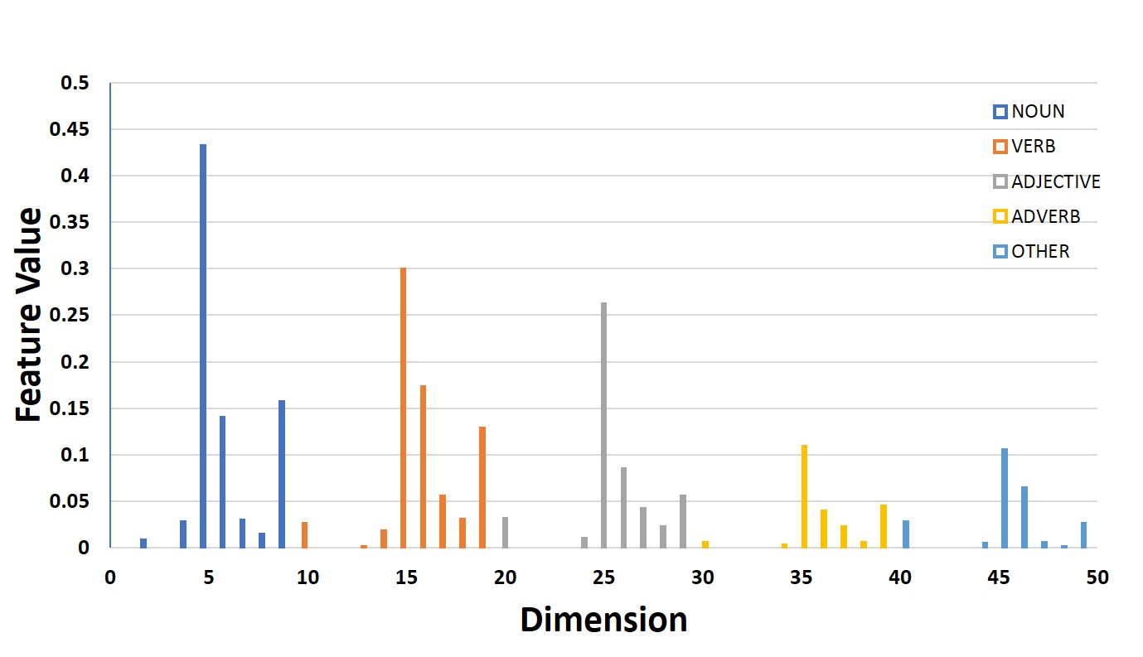
Token Level Features - HoPS
Captures the similarity pattern between RA and SA.
For each word in RA, find the similarity score with respect to SA as :
Partition these similarity scores into N bins.
The bin index is computed as :

Slide 9
Token Level Features – HoPSTag + Question Type
HoPSTag – HoPS with Part of Speech tags.
For 5 POS Tag types (Noun, Verb, Adjective, Adverb, Other), create N bins each.
Feature Dimension: 5N
More granular features and useful with question types.
Question Type Features.
A Who question expects a noun as answer.
Add binary features for 8 question types – How, What, Why, Who, Which, When, Where, Whom.

Slide 10
Token Level Features - Overall
3 Word Overlap features.
50 HoPSTag features – 10 HoPS features for 5 POS Tags.
8 Question Type features.
HoPSTag Features averaged over all partially correct answers in SemEval-13 dataset.

Slide 11
Sentence Level Features
Use InferSent pre-trained model to generate embeddings for the question (q), reference answer (r) and student answer (s).
Without question embedding
S(q, r, a) = (r*a, |r-a|)
With question embedding
S(q, r, a) = (r*a, |r-a|, (q*r), |q-r|, q*a, |q-a|)
Unseen Answer test set – using question embedding should help.
Interpretations:
(r*a, |r-a|) - information gap between student and reference answer.
(r*q, |r-q|) - novel information in reference answer.
(q*a, |q-a|) - novel information in student answer.

Slide 12
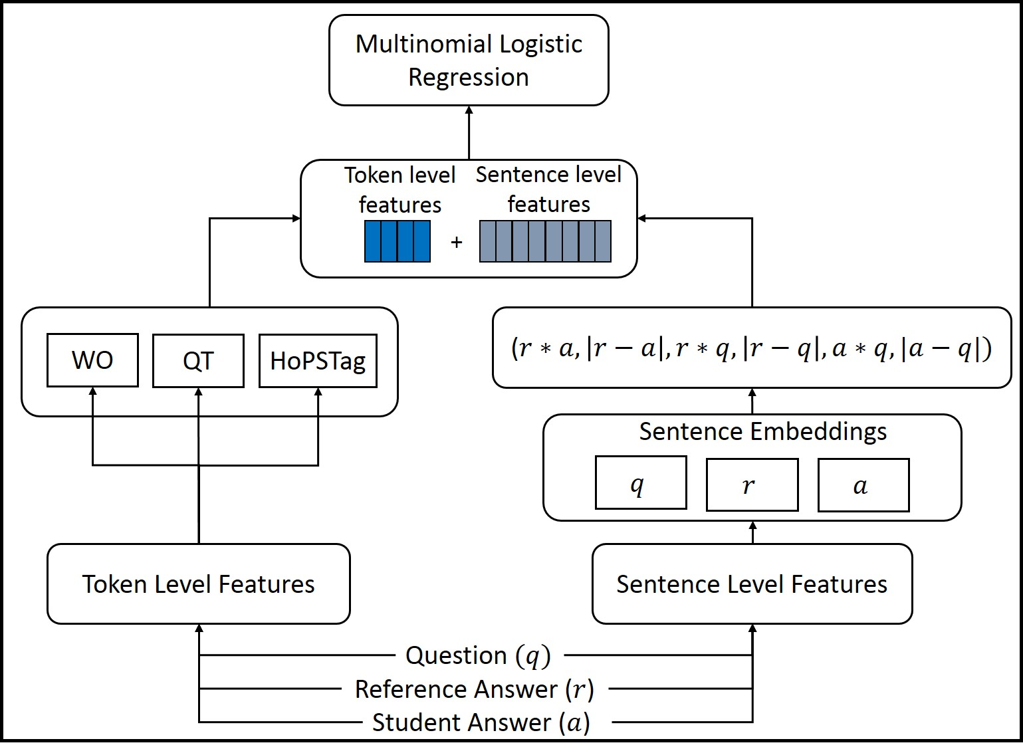
Final Architecture

Slide 13
Datasets
Large Scale Industry Dataset – 3 class Classification task (Correct, Partially correct, Incorrect).
SemEval-2013 Dataset –
2-way Classification task (Correct, Incorrect).
3-way Classification task (Correct, Incorrect, Contradictory).
5-way Classification task (Correct, Partially correct, Contradictory, Irrelevant, Out of domain)
Mohler et al. Dataset – Regression task (Score range – [0,5])

Slide 14
Results – Industry Dataset
Ablation Study of Token Level Features
We achieve much better results than two SOA methods

Slide 15
Results – SemEval-2013 Dataset
Beats SOA systems from
the shared task

Slide 16
Results – Mohler et al. Dataset

Slide 17
Conclusion
Existing techniques in Automatic Short Answer Grading use either token level or sentence level features.
Token level features are ineffective in capturing semantics.
Sentence level features fail for non-sentential answers.
We introduce novel token level features – Histogram of Partial Similarities (HoPS) for understanding partially correct answers.
We show that token level and sentence level features have complementary benefits.
We propose a model that combines them.
Extensive evaluation in a large scale industry dataset and two benchmarking datasets show state-of-the-art performances.

